Slide 1
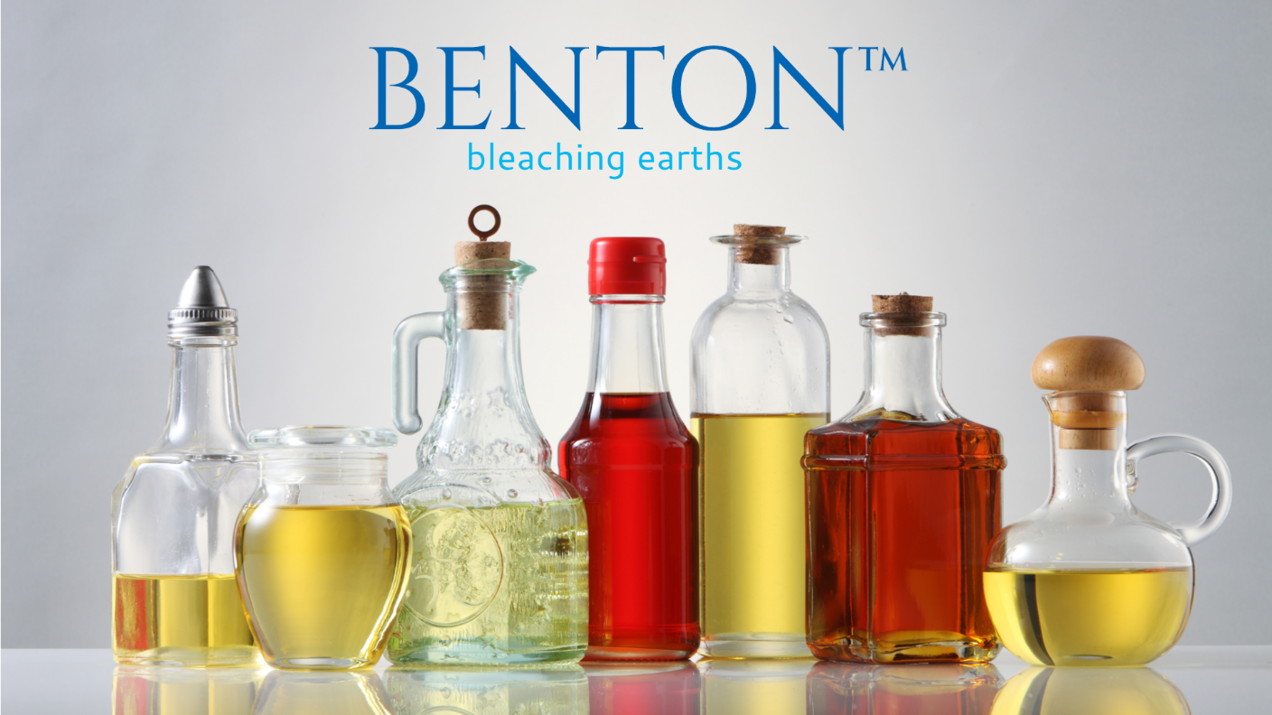
Copyright 2025, ARAC INTERNATIONAL LLP
ENGLISH

Slide 2
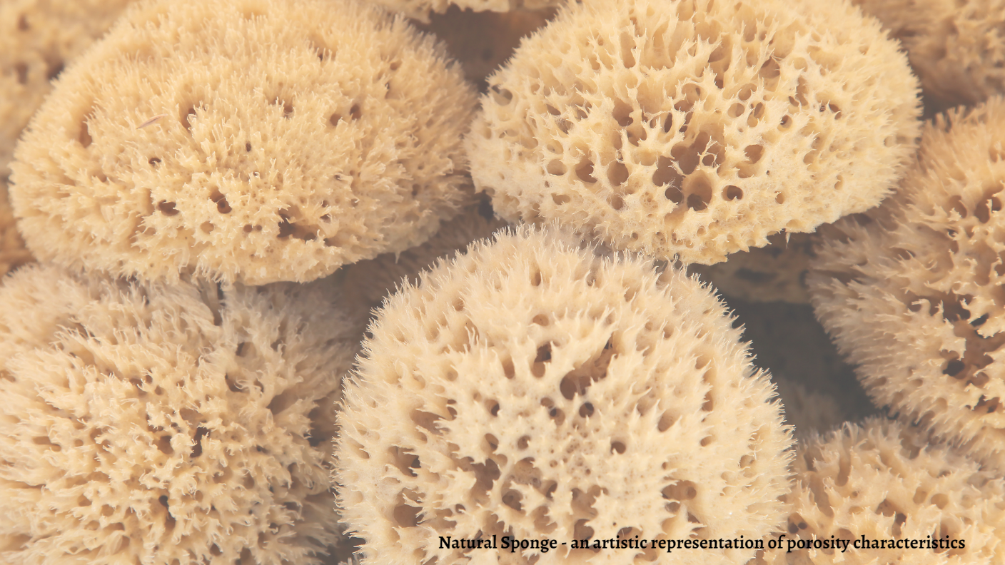

Slide 3

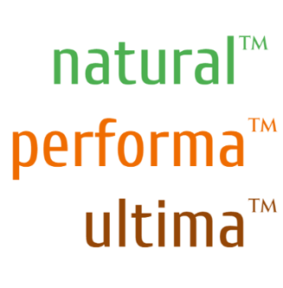
BLEACHING EARTHS
FOR EDIBLE OILS & BIO-FUELS
BENTON-earths™ Bleaching Earths offer edible oil refineries & Bio-Fuel processors key-processing ingredient to produce clear, clean and healthy edible oils & sustainable fuels.
BENTON-earths™ bleaching earths are classified into three product families: Natural, Performa and Ultima. Our product families are designed to offer a range of performance options depending on edible oil origin, oil type, process and expected quality of Refined Edible Oil.
BENTON-earths™ products originate from a diverse mineral deposits located in Kutch & North Karnataka regions. The clay in both regions features a high active surface area and high micro-pore volume. These features are well suited for the removal of chlorophylls, color bodies, soaps and other impurities from edible oils & bio-fuels.

Slide 4
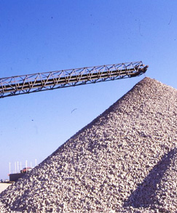
BENTONITE: FOUNDATION OF OUR BUSINESS
Bentonite contains clay minerals of the smectite group. The main constituent, which is the determinant factor in the clay's properties, is the clay mineral montmorillonite. Bentonite has the particular properties of swelling, high surface area and strong binding properties.
Smectites are clay minerals, i.e. they consist of individual crystallites the majority of which are <2µm in largest dimension.
Smectite crystallites themselves are three-layer clay minerals. They consist of two tetrahedral layers and one octahedral layer.

Slide 5
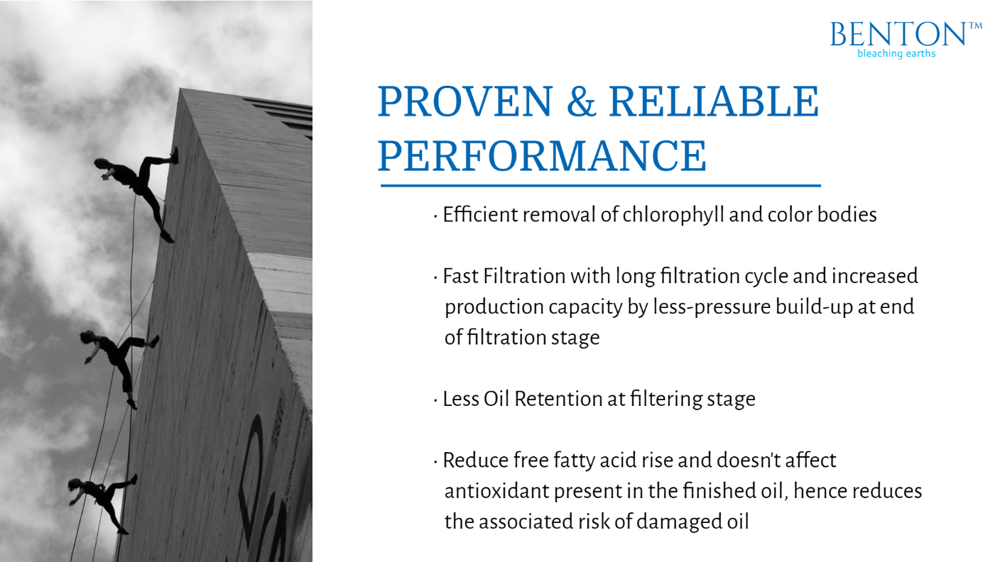
PROVEN & RELIABLE PERFORMANCE
Efficient removal of chlorophyll and color bodies
Fast Filtration with long filtration cycle and increased production capacity by less-pressure build-up at end of filtration stage
Less Oil Retention at Filtering Stage
3-MCPD & GE compliant
Reduced Free Fatty Acid rise and doesn’t affect anti-oxidant present in the finished oil, hence reduces the associated risk of damaged oil

Slide 6






OUR UNIQUE APPROACH
MINING
PRODUCTION
CONTROLLED QUALITY TESTING
CUSTOM
PACKAGING
LOGISTICS
Selective Mining from large-base of mining sites.
Long-term contracts with mine owners for secure supply.
Manufacturing with state-of-art factories
Customer specific tailored production
Focus on Quality Consistency
3-stage Quality Tests to match customer demand quality: Plant Lab; Owned-Lab; Independent Lab
Custom Packaging as per client’s need
25/50 Kgs HDPE paper-coated bags / Jumbo bags / Bulk
Multi-model logistics solutions
In Containers (20’/40’) or Break-bulk

Slide 7
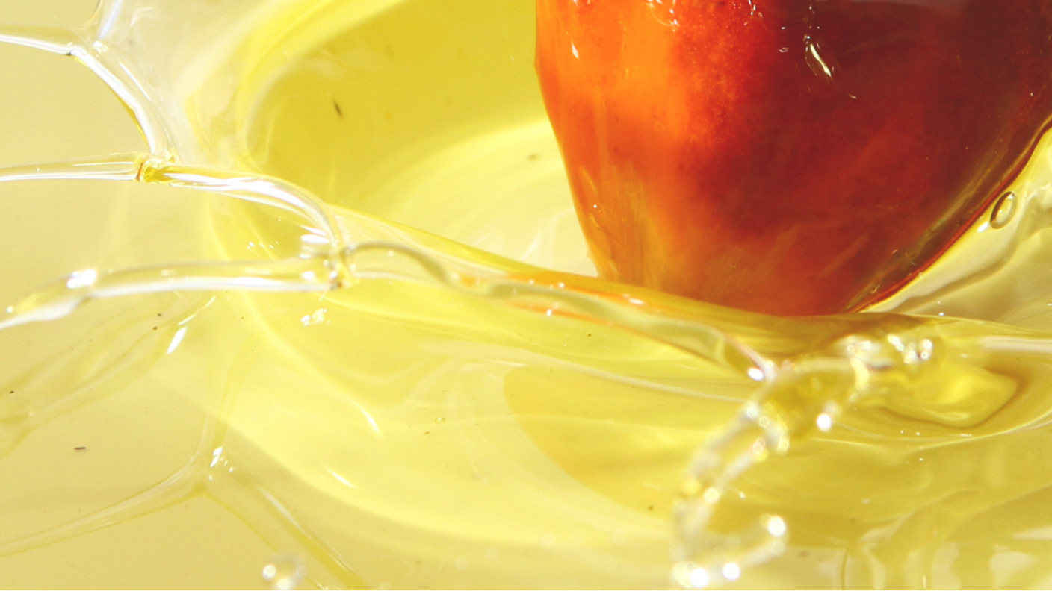

Slide 8
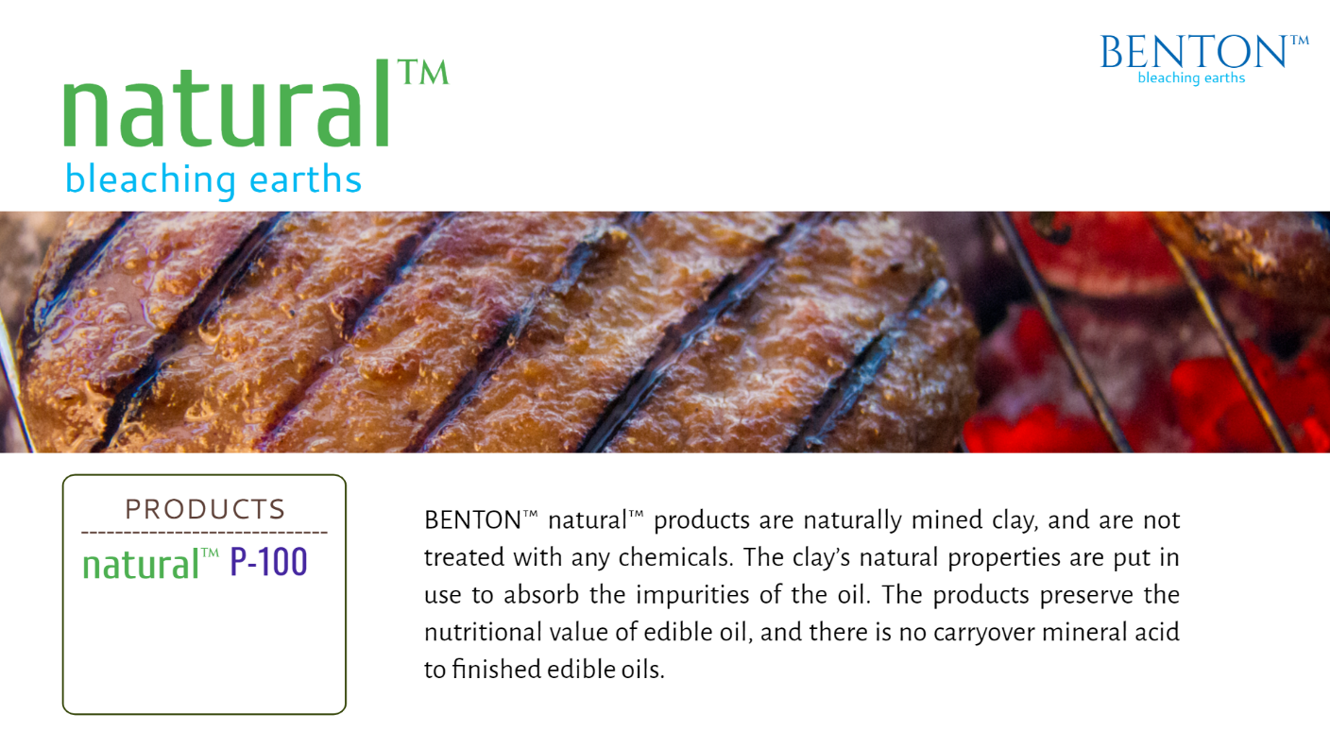

PRODUCTS
BENTON-earths™ natural products are naturally mined clay. The clay’s natural properties are put in use to adsorb the impurities of the oil. The products preserve the nutritional value of edible oil, and there is no carryover mineral acid to finished edible oils. These products are also 3-MCPD & GE compliant.
z
G
BMR100
ULTRA
BENTON-earths™ natural products are ideal to use in easy to bleach edible oils such as CPO, CPL, Corn Oil, Canola Oil, Sunflower Oil, Coconut Oil, Olive Oil etc.
PALMEX

Slide 9
NATURAL BLEACHING APPROACH
This Chart illustrates how the introduction of a typical dosage (0.6% and 0.8%) of BENTON-earths™ natural™ PALMEX during bleaching and deodorizing process can help achieve a significant reduction in R-color in CPL.
*Actual Plant conditions according to AOCS official method guideline at Kenyan Client’s 500 TPD Refinery.

Slide 10
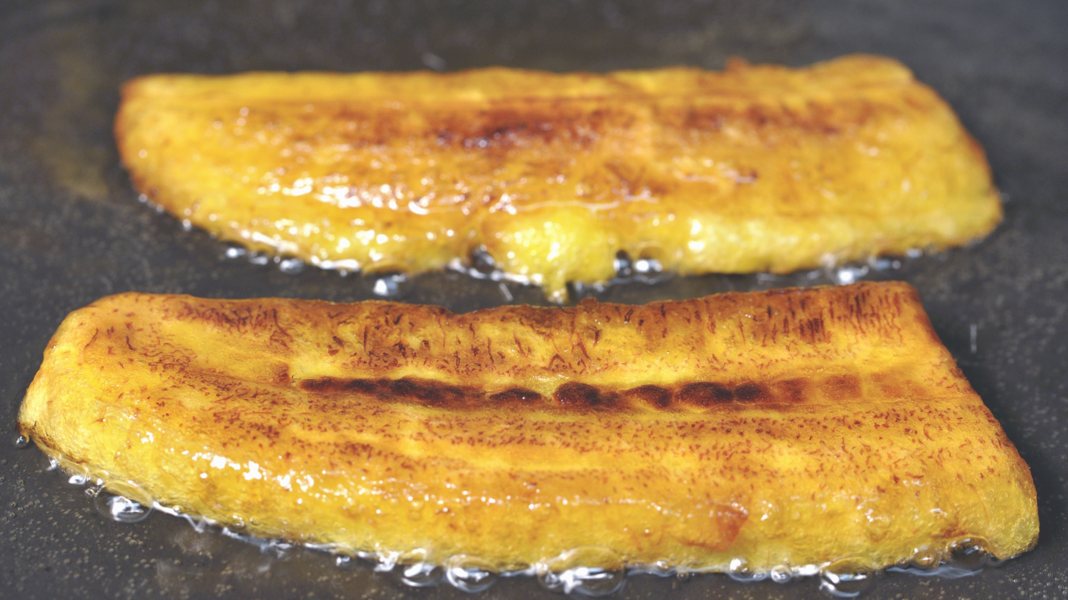

Slide 11
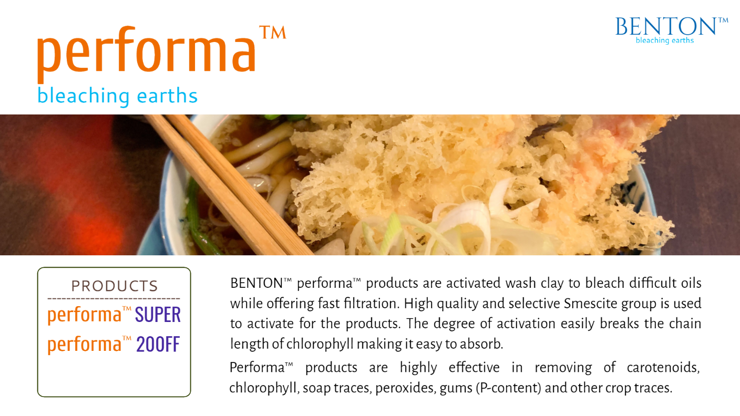

PRODUCT
BENTON-earths™ Performa are activated bleaching earth with high quality and selective Smescite minerals as base material. The degree of activation breaks chlorophyll chain-length making it easy to absorb while offering fast filtration.
The products are highly effective in removing of carotenoids, chlorophyll, soap traces, peroxides, gums (P-content) and other crop traces. The product range is ideal to use in difficult to bleach edible oils such as Soybean Oil, Cottonseed Oil, Palm Kernel Oil etc.
200FF
CAROSOL 20

Slide 12
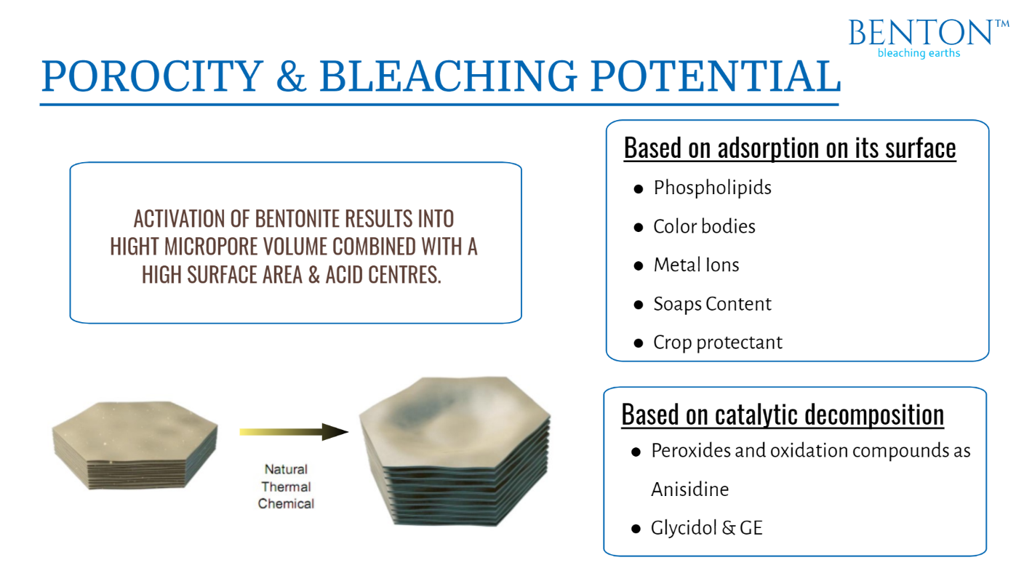
Natural Ca-Bentonite
Ca-Bentonite after Activation
Chemical
Surface Area ~60 m²/g
Loose bulk density ~850 g/l
Surface Area 300-350 m²/g
Loose bulk density ~600 g/l

Slide 13
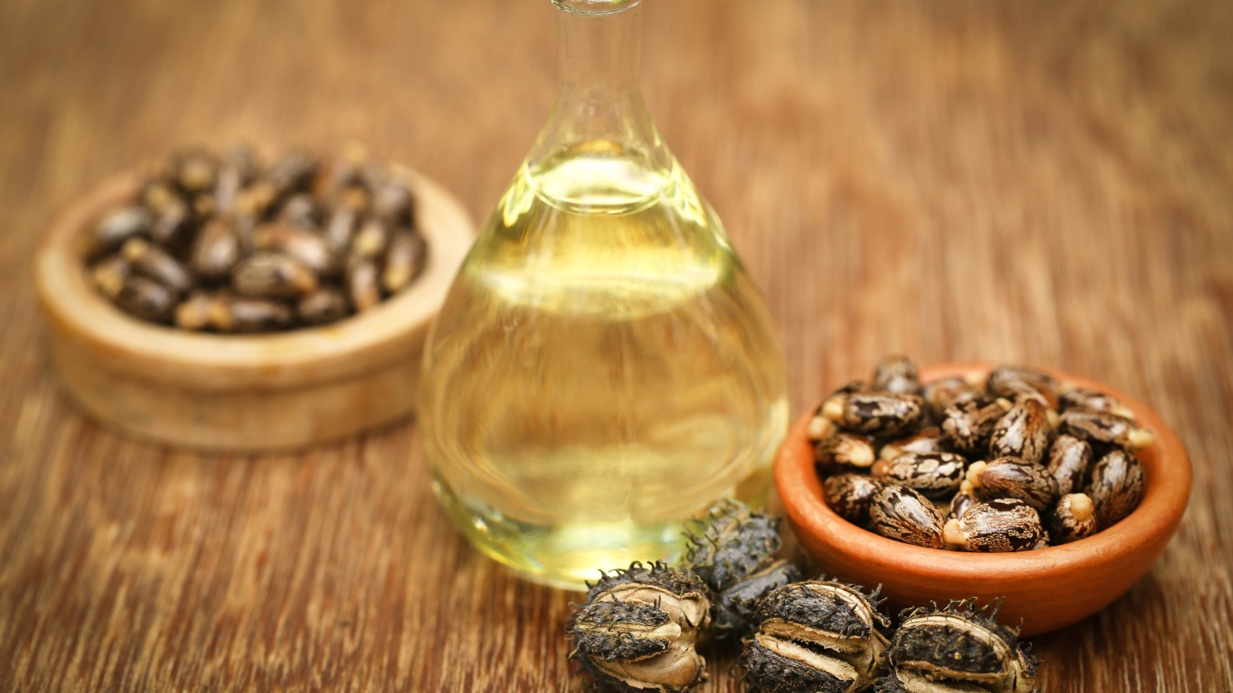

Slide 14
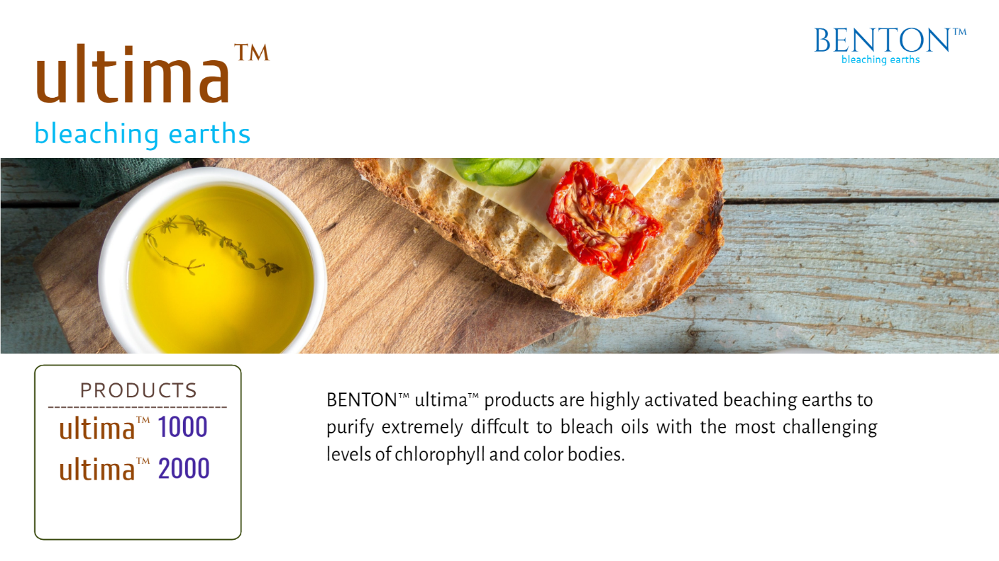

PRODUCTS
BENTON-earths™ ultima™ products are specialised bleaching earths to purify edible oils & bio-fuel with record high filtration time to offer high running efficiency at plant.
Ultima™ products can be used in all edible oil & bio-fuels purification.
300
1000

Slide 15
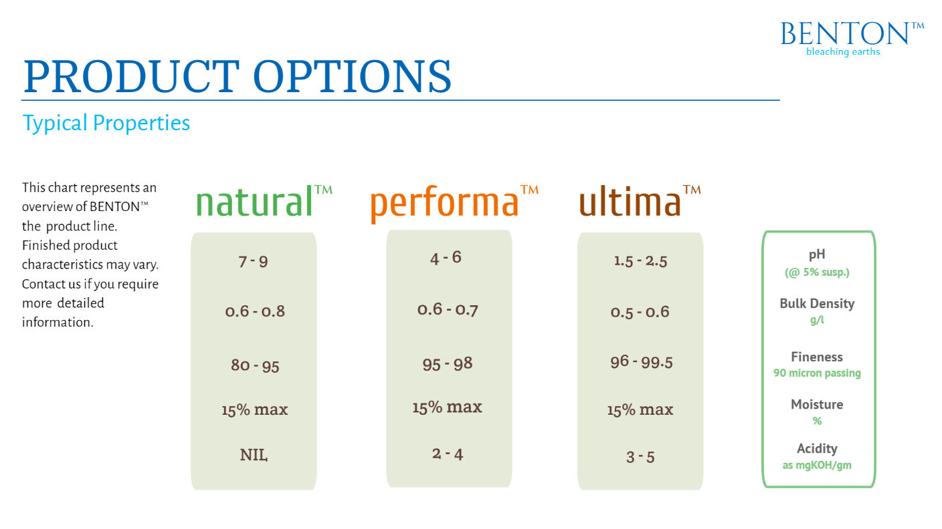




Slide 16






GLOBAL PRESENCE
HEAD OFFICE
120, Commercial Complex B, Airport Ring Road
Bhuj Kutch INDIA 370001
+91 99259 10009
contact@aracint.com
ayaz.khatri@aracint.com
Manufacturing Plant 1
PLOT NO 241-245, KOLHAR INDUSTRIAL AREA, BIDAR,
KARNATAKA 585403
Manufacturing Plant 2
610, GIDC BHUJ, BHUJ
KUTCH GUJARAT
370001 INDIA
Copyright 2024, ARAC INTERNATIONAL LLP
www.AracInt.com

